Slide 1
GET TO KNOW SIGMA
January 2020

Slide 2
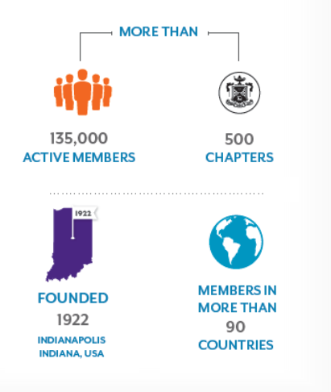
A Quick Look at Sigma
Adams
Belford
Copeland
Lingeman
Miller
Wright
Sigma was founded in 1922 by six nurses at the Indiana University Training School for Nurses
Remains headquartered in Indianapolis, Indiana
Notes:
Let's begin by talking about Sigma's history and where the organization is today.
Sigma Theta Tau International Honor Society of Nursing was founded in 1922 by six nurses at the Indiana University Training School for Nurses, now known as the Indiana University Nursing School, in Indianapolis, Indiana. This is where the organization's headquarters remain today, and is what you see in the middle photo on screen.
The organization is now simply referred to as Sigma, but remains a prestigious honor society with over 135,000 members, in 500 chapters, in more than 90 countries world wide. Sigma also collaborates with several global organizations to improve the health of the world’s people, including representation at the United Nations.
Every year on 5 October, the organization celebrates Founders’ Day, to honor our long history and the nurses who gave us our beginnings.

Slide 3
Name and Values
Love
Courage
Honor
SIGMA
THETA
TAU
Notes:
The founders chose the Greek Letters – Sigma, Theta, Tau –
taken from the Greek words meaning Love, Courage, and Honor, as they believed them to be the enduring values that are the root of the nursing profession.

Slide 4
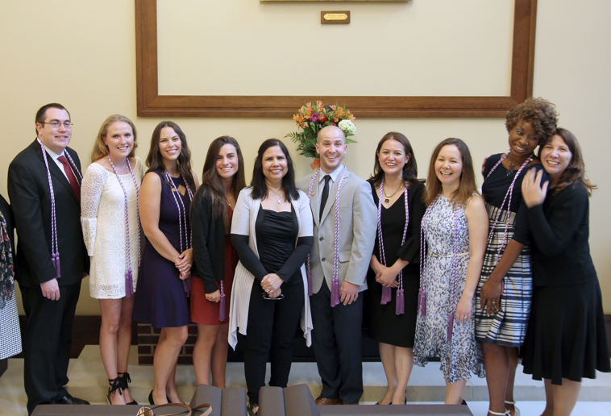
How Members Are Selected
Undergraduate/Baccalaureate Criteria:
Completed at least ½ of the nursing curriculum
Achieve academic excellence
Rank in top 35%
Meet expectations of academic integrity
Graduate/Masters & Doctoral Criteria
Criteria above
Completed at least ¼ of the nursing curriculum
Can also be inducted as a nurse leader
Nurse Leader Criteria
Minimum of baccalaureate or equivalent in any field
Demonstrate achievement in nursing excellence
Legally recognized to practice nursing

Slide 5
2019-2021
Presidential Call to Action
Richard Ricciardi, PhD, CRNP, FAANP, FAAN 2019-2021 Sigma President
Notes:
As mentioned, each biennium, Sigma installs a new president at the international level. At the 45th Biennial Convention, we proudly installed Richard Ricciardi, PhD, CRNP, FAANP, FAAN and introduced him as the 33rd president of Sigma.
Each president presents a call to action to help guide members and chapters throughout the biennium.
President Ricciardi's call asks us to infuse joy into all we do. All healthcare workers face challenges that can trigger burnout, such as staffing shortages, incivility or violence, lack of control in the workplace, barriers to education, and misaligned policies and regulations. Instead of viewing these issues as insurmountable and inevitable, he asks us to seize the opportunity to improve our experiences and work cultures.
To learn more and participate in fulfilling President Ricciardi’s Call to Action visit Sigma’s website, sigmanursing.org.

Slide 6
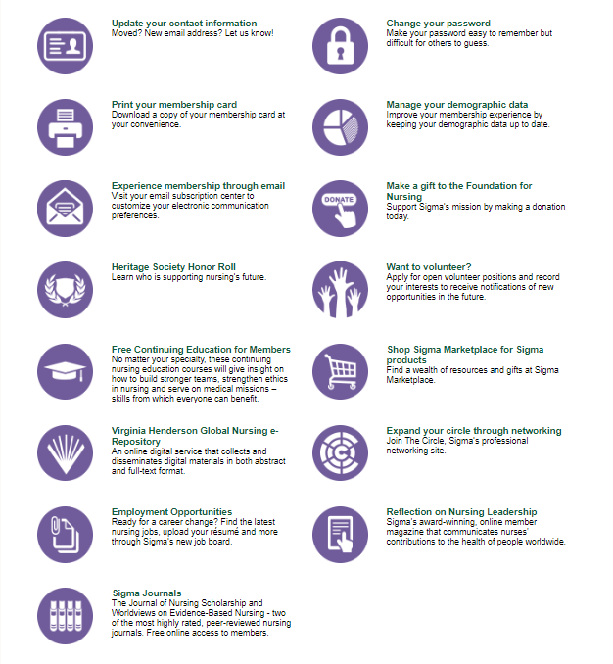
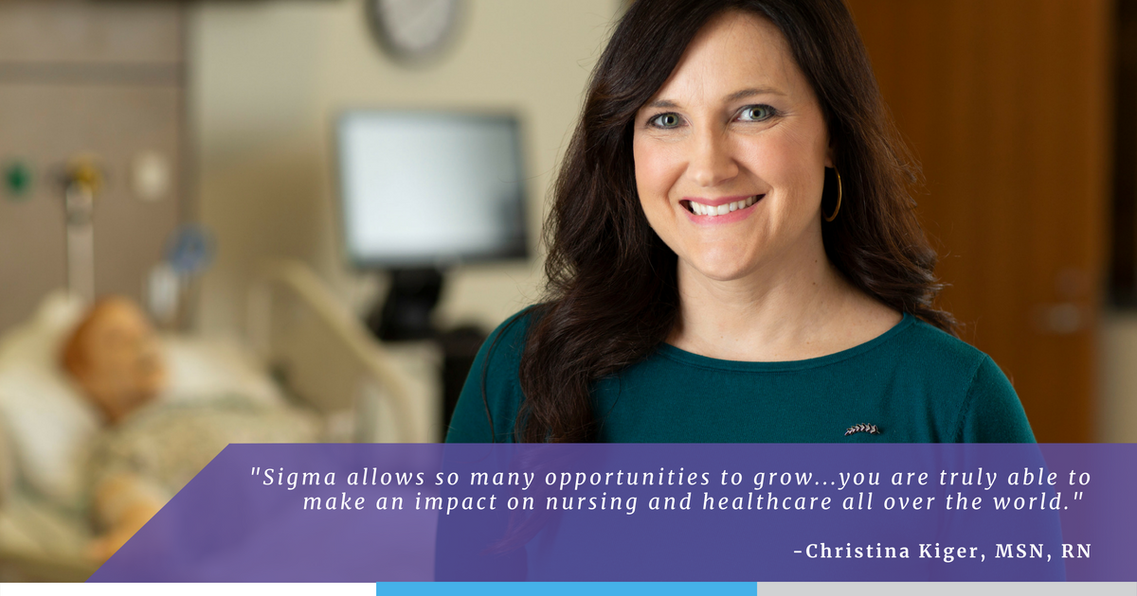
Get Connected via My Membership
http://membership.sigmanursing.org
Login: email address on file
Password: 7 digit member ID number
Notes:
Now that you understand more about how Sigma is organized, we will talk about how members can get connected within the organization and design their own membership experience.
The My Membership website is the place members access certain benefits, update contact information, utilize the member directory, and more.
Quick, easy to access links to member benefits are also available, like Sigma’s journals, continuing nursing education, volunteer opportunities, and The Circle.

Slide 7
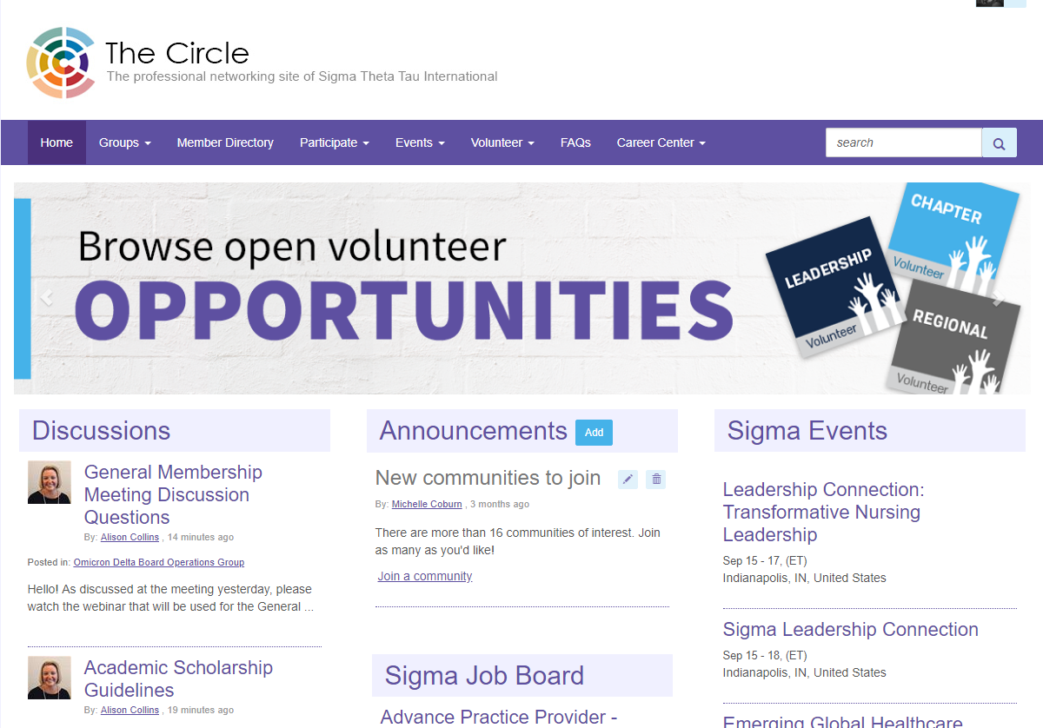
Notes:
The Circle is Sigma's online member community and professional networking site, and a benefit with active membership. In between chapter meetings and events, it's a place where you can go to be a Sigma member.
On screen is The Circle home page where you’ll find a wealth of resources and conversation spaces to support you as a student or professional, and help you connect with other Sigma members all over the world.
Sigma events are also displayed on the right column. One webcast to check out right after joining is called “What’s Next? A Virtual Tour of Sigma.” These monthly webcasts are presented by staff at international headquarters and will take you on a tour of Sigma’s virtual platforms and benefits, and show you how to make the most of your membership.

Slide 8
Communities of Interest & Forums
Workgroups
My Membership
Chapter Websites
Career Center
International Opportunities
Notes:
On screen is the basic structure of The Circle. Within the community, you'll find over 16 discussion based Communities of Interest and forums, workgroups for committees and task forces at the international level, Sigma's career center, chapter and international volunteer opportunities, and chapter websites. A lot of active member benefits are accessed through this site.

Slide 9
Ambulatory Care Community
Cardiovascular Community
Case Management Community
Community Health Community
Complementary Health Approaches Community
Critical Care Community
Disaster Preparedness Community
Emergency Nursing Community
Geriatric and Dementia Care Community
Hospice and Palliative Care Community
Medical/Surgical Community
Mental Health Community
Nurse Educators Community
Nursing Informatics Community
Oncology Community
Pediatrics Community
Global Member Forum
Career Advice Forum
My Membership
Notes:
As mentioned, there are 16 Communities of Interest, with each representing a different nursing specialty or topic. Members are having thoughtful and important conversations in the discussion forums within each community, about research, scholarly articles, trends, best practices and more. You can join any that interest you and begin lending your voice to the discussion.
There are also two forums: One is the Global Member Forum, which is for general topic conversations and announcements, and the Career Advice Forum where volunteers and other members help answer career related questions.
You can find groups and communities to join from the "Groups" button on The Circle navigation. There you'll also find the "My Groups" page, that will show any groups you are a part of, including your chapter website.

Slide 10
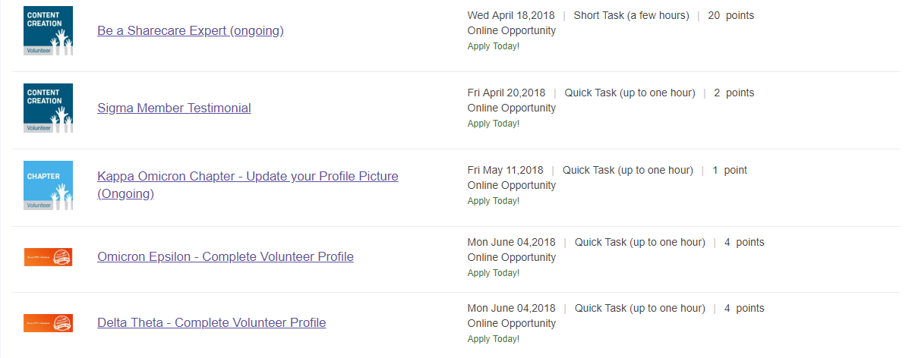
My Membership
Notes:
The Circle is also where members come to find international level and chapter level volunteer opportunities. Examples of international opportunities range from in-person volunteers at conferences, to submitting a Sigma member testimonial completely online. [Mention chapter volunteer opportunities if you utilize this feature.]

Slide 11
My Membership
Notes:
Finally, The Circle is home to the Career Center, where members can access Sigma's Mentor and Mentee program, as well as the member's only Job Board.

Slide 12
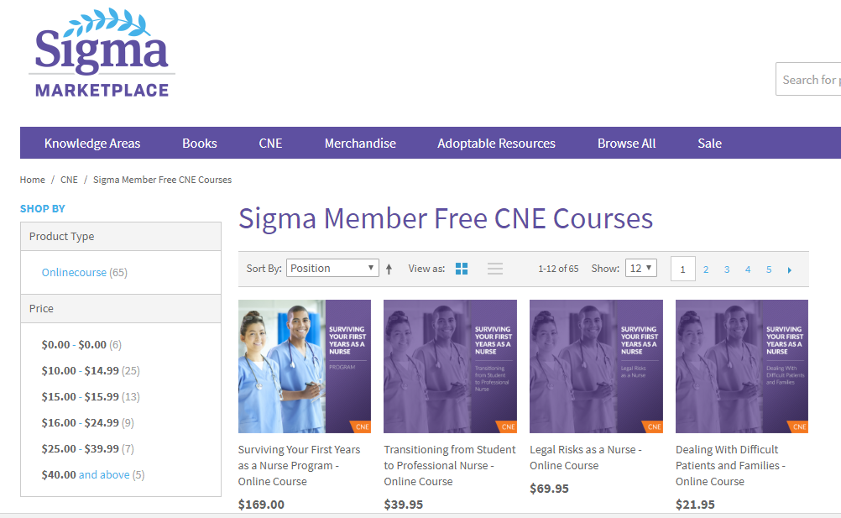
My Membership
Notes:
Another popular benefit new members like to take advantage of right away are the free and discounted continuing nursing education credits available with membership. There are currently over 65 free CNE credits members can take advantage of, and hundreds more available at a members only discount.
Many members like to get started with the course called, Surviving Your First Years as a Nurse, a US 169 dollar value.

Slide 13
My Membership
Notes:
Besides CNE, Sigma offers other knowledge based benefits. One of them is the Virginia Henderson Global Nursing e-Repository. This Sigma resource is the only nursing repository in the world, and allows authors to disseminate their information in the forms of research papers, theses, evidence based practice materials and more, while retaining copyright. It serves as a great digital resource for nurses, nursing students, nursing organizations, schools of nursing, and hospitals/healthcare systems. You can visit the repository at www.nursingrepository.org
Members also have free access to two, highly-ranked, scholarly based journals: Worldviews on Evidence Based Nursing, and Journal of Nursing Scholarship. JNS contains peer-reviewed, thought-provoking articles representing research by some of the world’s leading nurse researchers. Worldviews on Evidence-Based Nursing, a peer-reviewed, evidence-based nursing journal, is a primary source of information to improve patient care.
Sigma also publishes Reflections on Nursing Leadership, or RNL, a virtual magazine with content that changes daily, covering nurses’ contributions and relevance to the health of people worldwide.

Slide 14
My Membership
Notes:
And finally, Sigma sends members an email called Sigma Update on the first of every month. This membership email contains information about important dates, grant and funding opportunities, volunteer positions and other international initiatives.

Slide 15
Chapter Leadership
Notes:
[Insert information about chapter leadership]

Slide 16
Upcoming Chapter Events
Spring 2020
Lesbian, Gay, Bisexual, Transgender, Queer or Questioning, Intersex, and Asexual or Allied (LGBTQIA) Nurse Research Presentation by Melissa Harker, DNP, RN
Human Trafficking Presentation
Ongoing Community Service Events
Trenton Area Soup Kitchen
United Nations Visit (NYC)
My Membership
Notes:
We want to let you know about the upcoming events and programs planned for members.
[Insert upcoming chapter dates]

Slide 18
Upsilon Rho Chapter Website https://thecircle.sigmanursing.org/upsilonrhochapter/home Interested in becoming more involved? Reach out to Vicki Brzoza (Vbrzoza@tesu.edu) or Holly Leahan (Hleahan@tesu.edu)

